Slide 1
The College Analysis Increasing Student’s Ability to Pay
Mauricio Botero, Angela Felder, LaRia Rogers, Andrea Wise

Slide 2
THE BIG CONCEPT
Student tuition has significantly increased. Loan borrowers aren’t paying off their student loan debt.

Slide 3
The Problem
More than two-thirds of college graduates graduated with an average debt of about $35,000.00 in 2016. This is three times more than that in 1993-1994.
In 2014, the average salary was $46,481.52. while only increasing by less than two times the 1994 salary of $23,753.53.
A graduate first year out of college is likely to make below the national average. The average starting salary of 2014 college graduates with a bachelor’s degree was $45,473.00.

Slide 4
1-in-7 borrowers
DEFAULT.
Notes:
Federal student loan debt exceeds #1.3 trillion, and about one-in-seven borrowers default on their loans within three years of begging to repay them.

Slide 5

Notes:
Story…

Slide 6

Hypothesis
Will providing prospective students with a measurement based on the analysis of the median student loan debt to the median earnings improve the student’s ability to pay back their student loans?

Slide 7

You do the math!
Debt-to-Earnings Ratio = Total Median Debt / Total Median Earnings
Notes:
Your debt to income ratio is considered manageable if it is less than 10%. If your debt to income ratio exceeds 10%, it is considered to be extremely risky. Most research already conducted indicates that a student’s loan debt should not exceed more than 57% of their annual earnings, or 8% of monthly(CONFIRM) earnings.

Slide 8
College Scorecard
https://collegescorecard.ed.gov/data/
Sources:
National Center of Education Statistics
Integrated Postsecondary Education Data System
Federal Student Aid
National Student Loan Data Center
Treasury
Raw Data:
Data Document
Data Dictionary
18 Fiscal Years (1996 - 2013)
7,800 Schools
1,720 Data Elements
Notes:
Our data is from The College Scorecard DoE’s website. The College Scorecard is a White House initiative using data from…
NCES - sits in DoE with Institute of Education Sciences and responsible for collecting data related to education. Collects data from surveys and other data systems.
IPEDS - core postsecondary education data collection program for NCES. Collects annually fundamental data in areas such as enrollment, program completion and graduation rates, institutional costs, student financial aid, and human resources through surveys and other data systems.
FSA - Also an office of DoE and the largest provider of student financial aid in the nation. Responsible for managing over $150 billion in federal grants, loans, and work study funds each year. Provides oversight and monitoring of all program participants such as post-secondary schools and loan servicers.
NSLDS - FSA’s central database for federal student aid under Title IV. Receives data from post-secondary schools, guaranty agencies, servicers, and other FSA systems.
Treasury - Promotes economic growth through policies to support job creation, investment, and economic stability. Also oversees the production of currency.
The data was collected, formulated, calculated and published by the DoE. The data available through the College Scorecard consists of:
18 fiscal years (1996 - 2013)
7,800 OPEIDs - (Office of Postsecondary Education Identifier) including school locations for each year. The first six (6) digits identify a school’s primary campus and the last two (2) digits identify a specific location
1,720 data elements for each OPEID

Slide 9
What’s in our data
OPEID
School Demographics
School type
Average SAT score
Academic Programs
Median Loan Debt
Median Earnings
Notes:
We used the 2011 cohort = students first enrolled with Title IV aid in 2005 and earnings data matched from Treasury for 2011 earnings for that cohort of students (or 6 years after initial enrollment).
OPEID = Office of Postsecondary Education Identifier - 8-digit code (not smart) assigned by the DoE to identify each school and all locations for the school
Demographics include state, region, main website,
School Type = public, private for-profit, and private not for-profit
Median Loan Debt = for the cohort (based on entry year) of students that received title IV student loans. this is the total amount borrowed through the federal title iv stafford loan program
Median Earnings = the students within each cohort were matched with SSA data to obtain the median earnings 6-years after entry

Slide 10
The good ole Pipeline…
Data Ingestion
(College Scorecard)
Data Munging & Wrangling
(iPython Pandas)
Computation & Analysis
(Time Series Forecasting)
Modeling & Application
(Linear Regression)
Reporting & Visualization
(Tableau)
Notes:
Discuss analysis/sources/modeling- predictive regression, U.S. Dept of Ed Scorecard
Data Ingestion - csv file was downloaded from the College Scorecard website and ingested into python
Munging & Wrangling - used iPython and Pandas -
with such a large data set, we identified the key data elements needed for our study and removed all other elements.
next we removed duplicate data caused by school locations. for example: the University of Phoenix has over 350 locations. The data elements we used were duplicated across each location.
we identified null values existed within the median debt and earnings attributes. For the null values, we calculated and populated the nulls with an average median debt and earnings respectively.
Computation & Analysis - we used predictive and time series forecasting. With the debt and earnings data available from 2005, 2007, 2009, and 2011, we predicted the median debt and earnings for future odd years 2013 through 2021 and then calculated the debt-to-earnings ratios for each school.
Modeling & Application - we worked with several regression models such as Ridge, Randomized Lasso, and Bayesian Ridge. We determined Linear Regression provided the best model for our data.
Reporting & Visualization - using Tableau, we developed visuals to best represent our study.

Slide 11
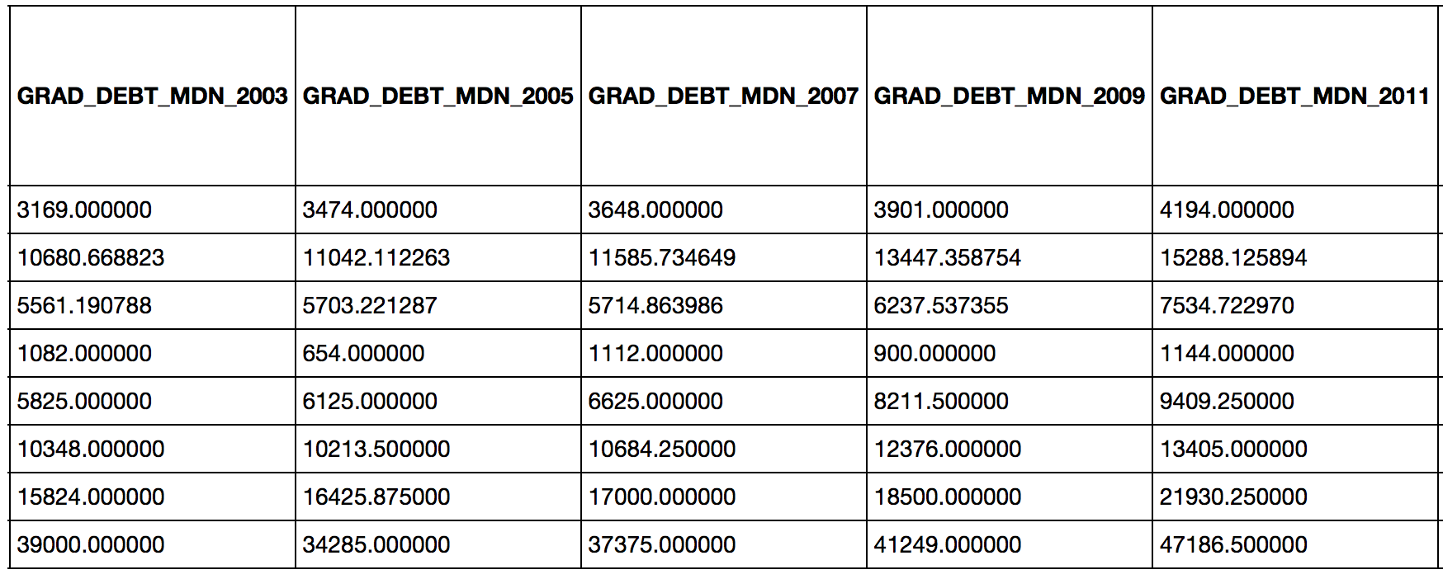
Wrangling Phase:
Data Selection, Missing data, Duplicate data

Slide 12
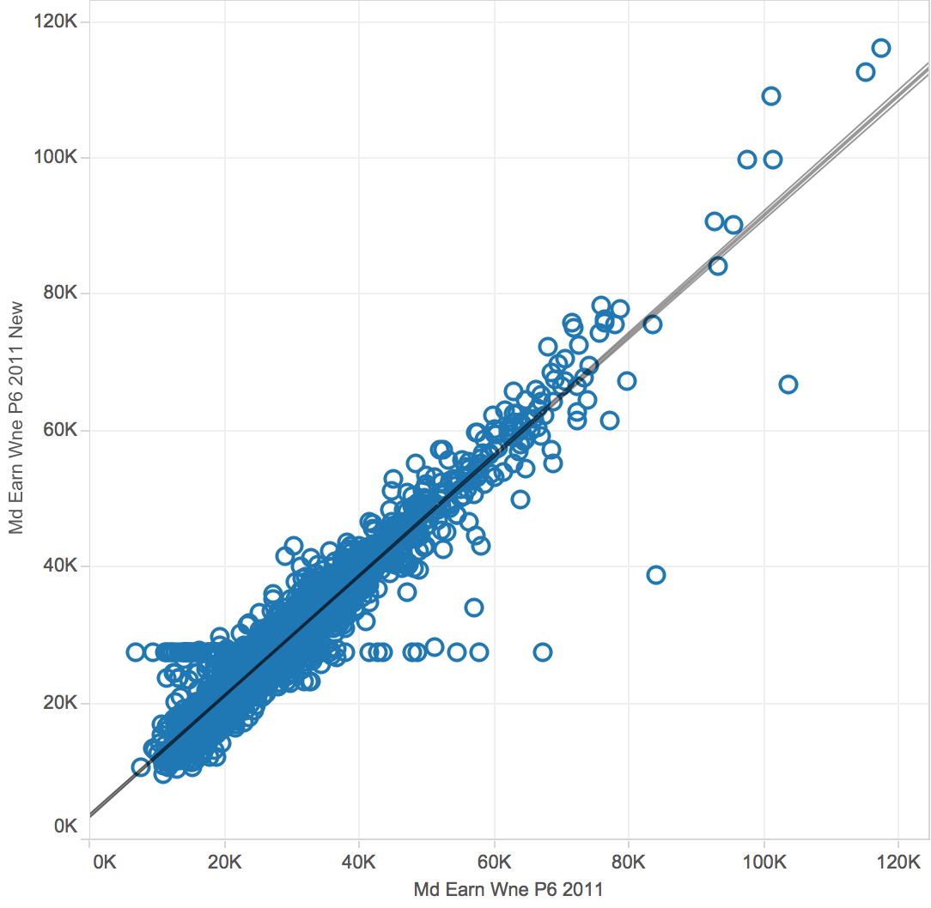
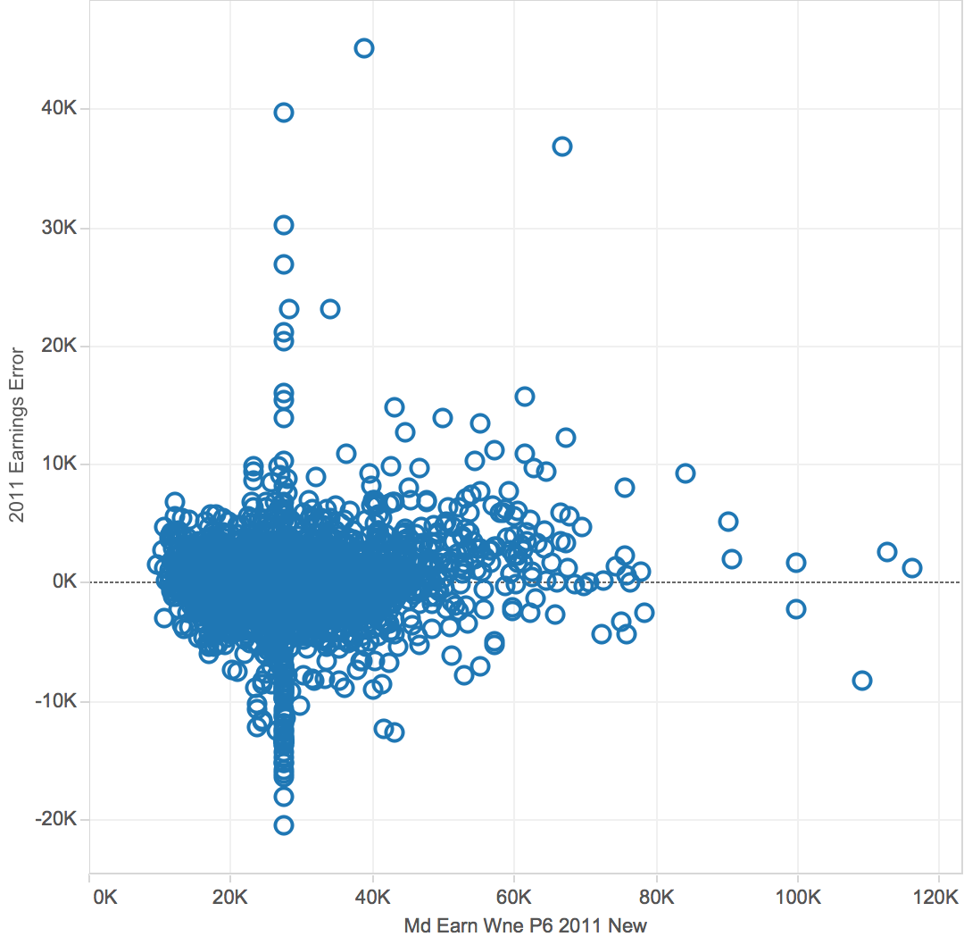
Computation & Analysis: (Earnings)
Earnings≙2011 = Earnings2009 + Earnings2007 + Earnings2005 + Earnings2003

Slide 13
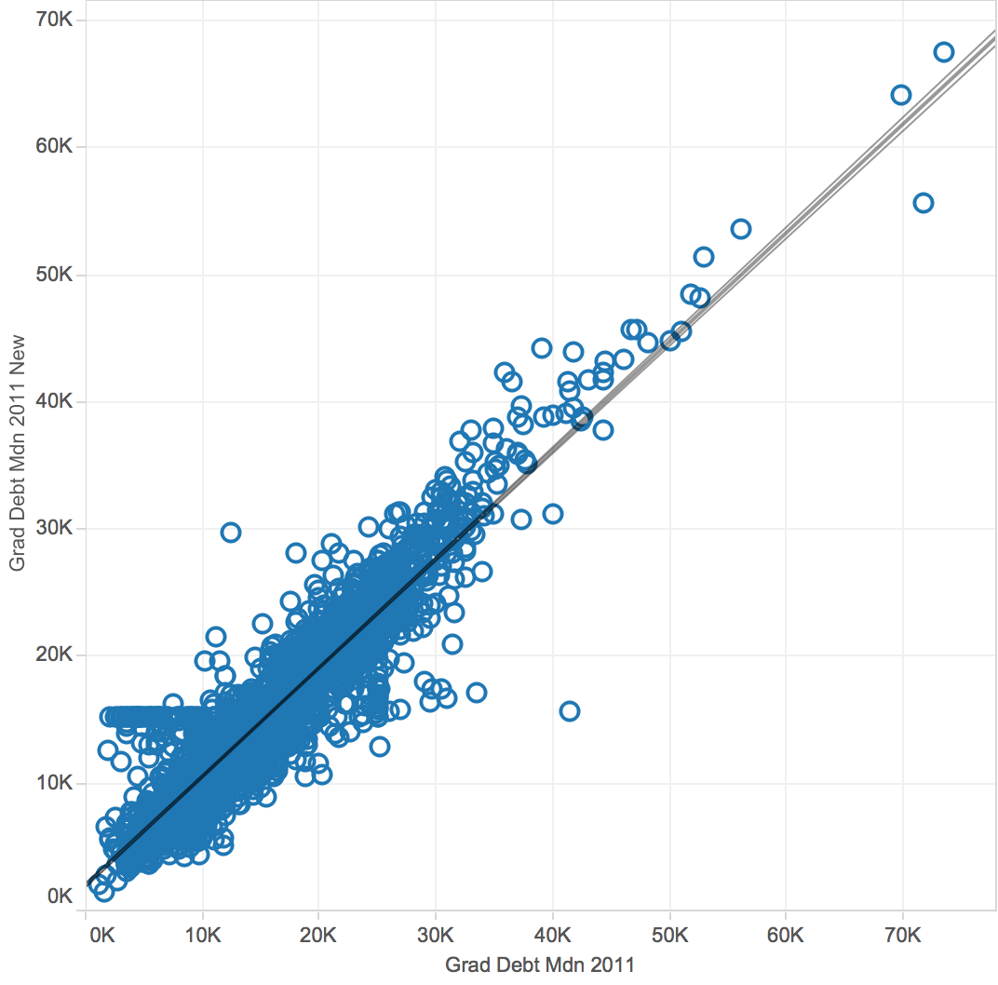
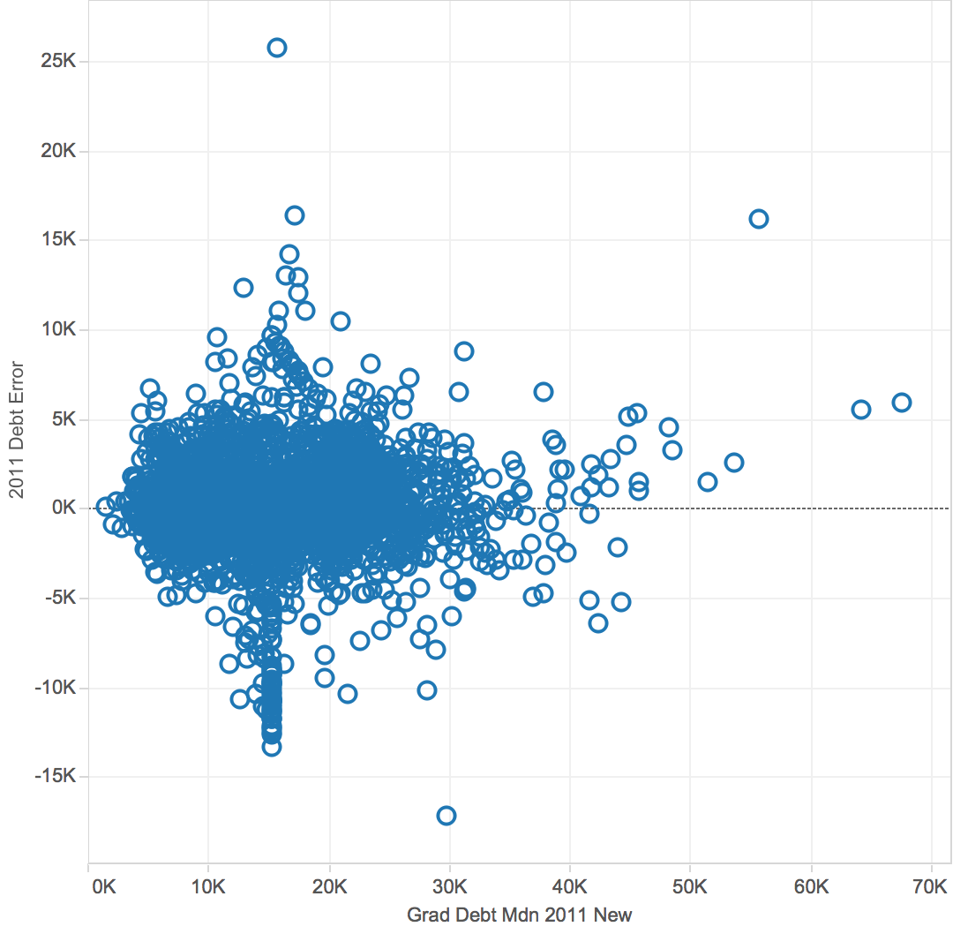
Computation & Analysis: (Debt)
Debt≙2011 = Debt2009 + Debt2007 + Debt2005 + Debt2003

Slide 14
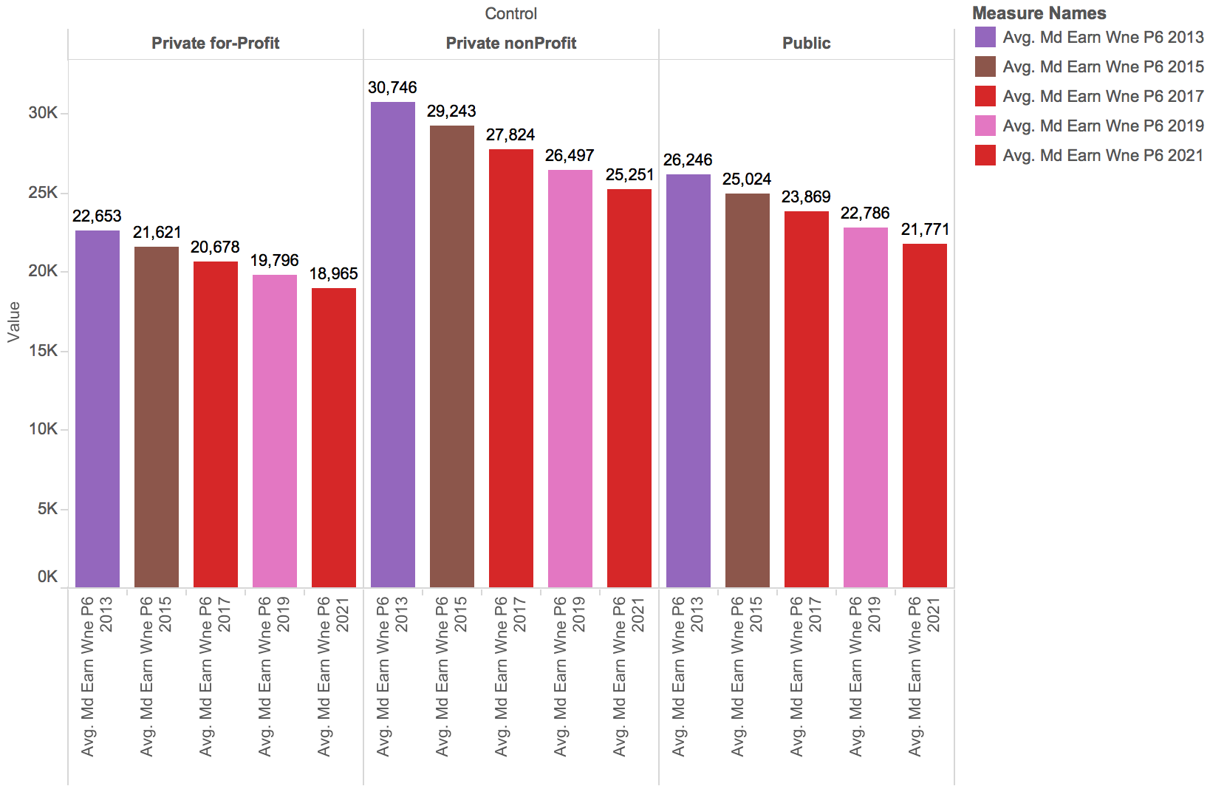
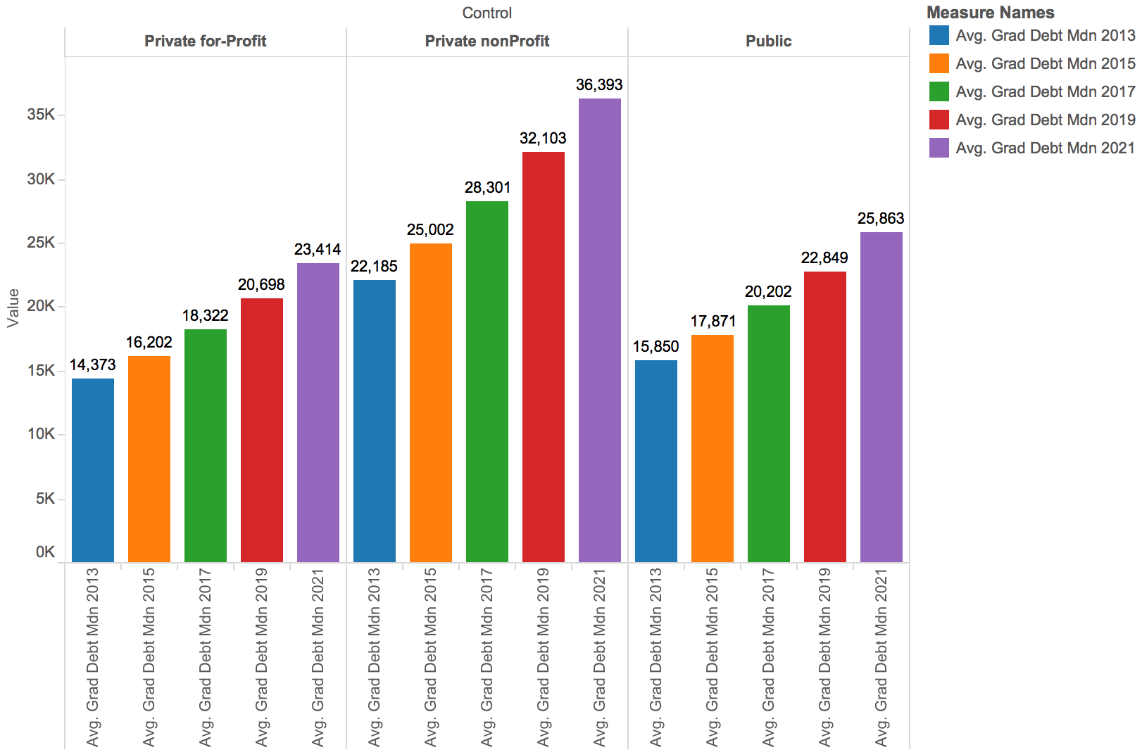
Modeling & Application:

Slide 15
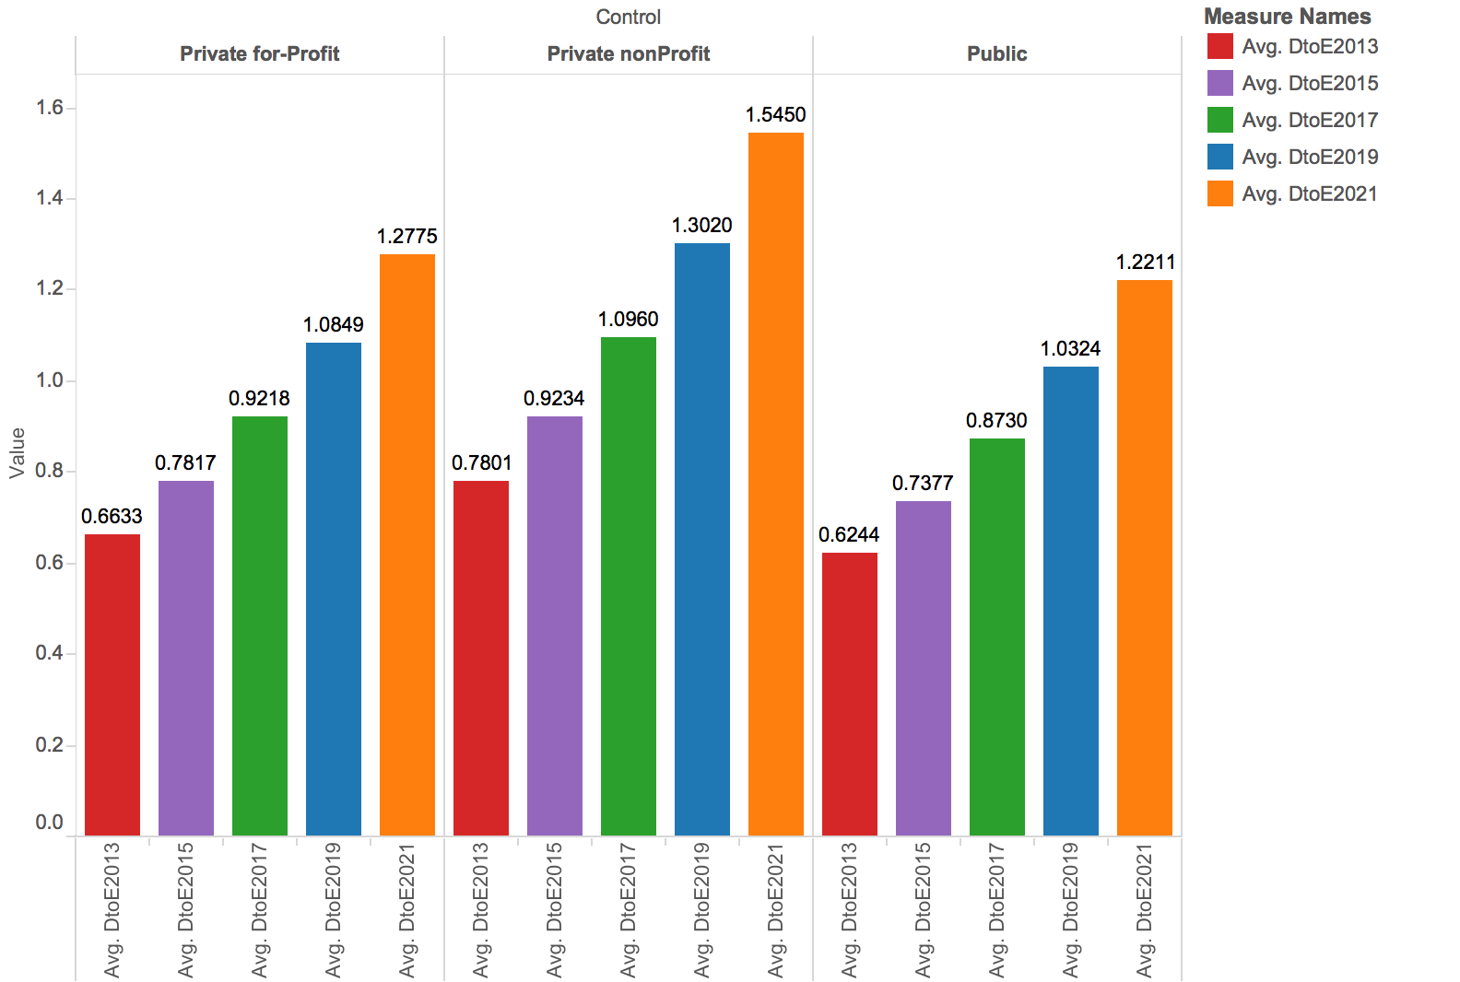
Modeling & Application:

Slide 16
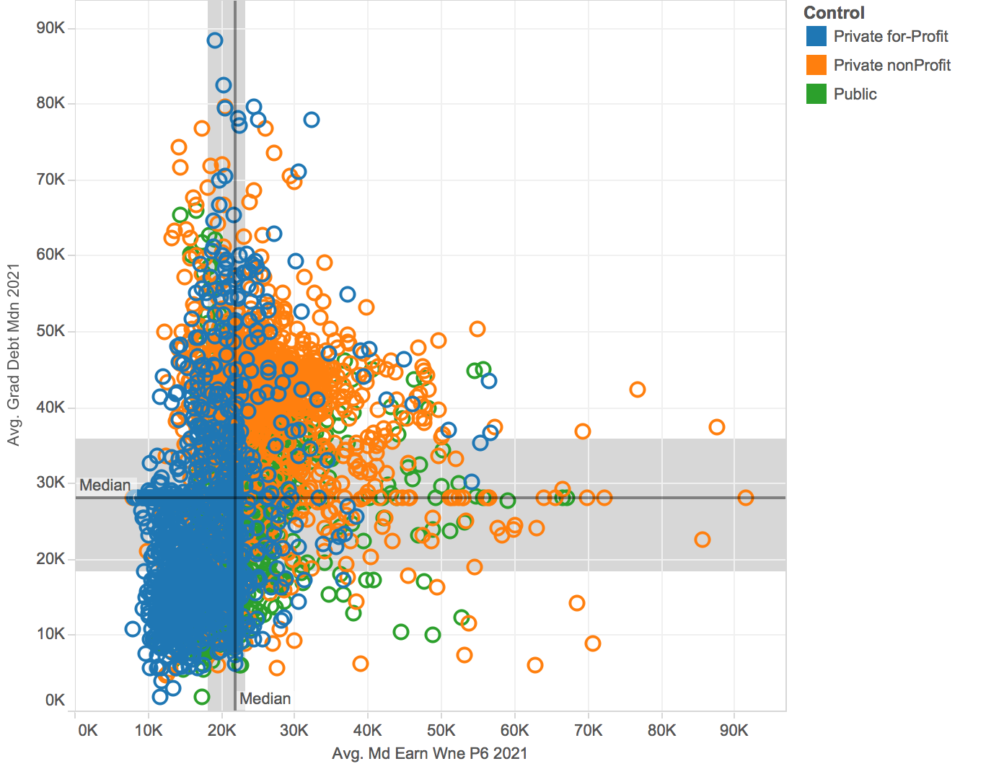
Visualization and Reporting:
Poor Performers
Outperformers

Slide 17
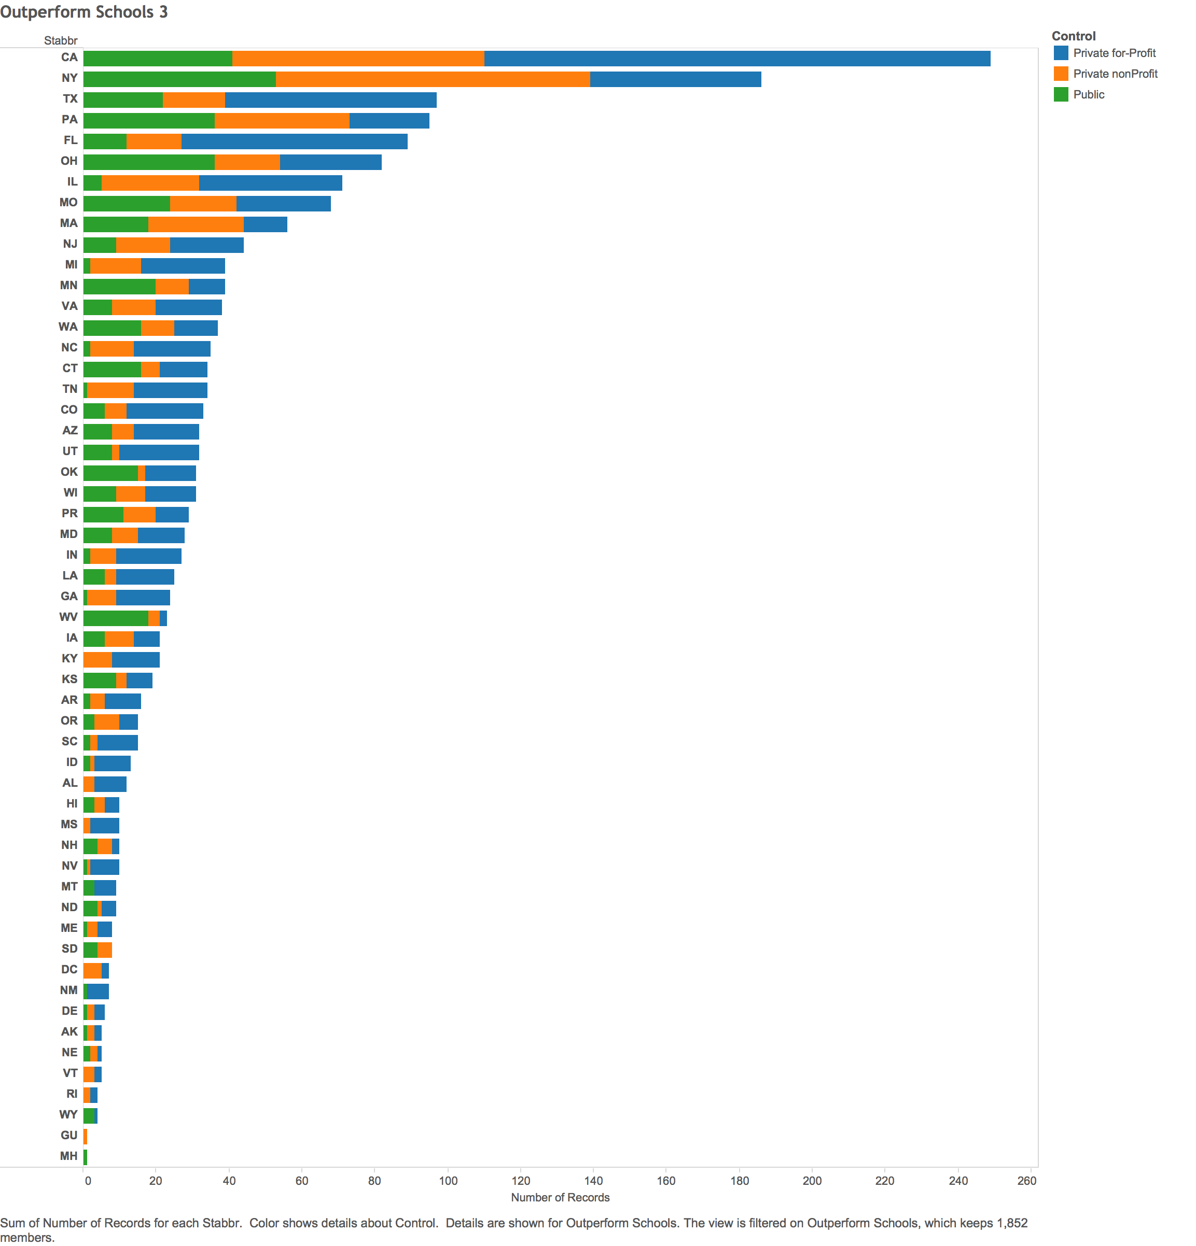
Recommendations - Outperformers

Slide 18
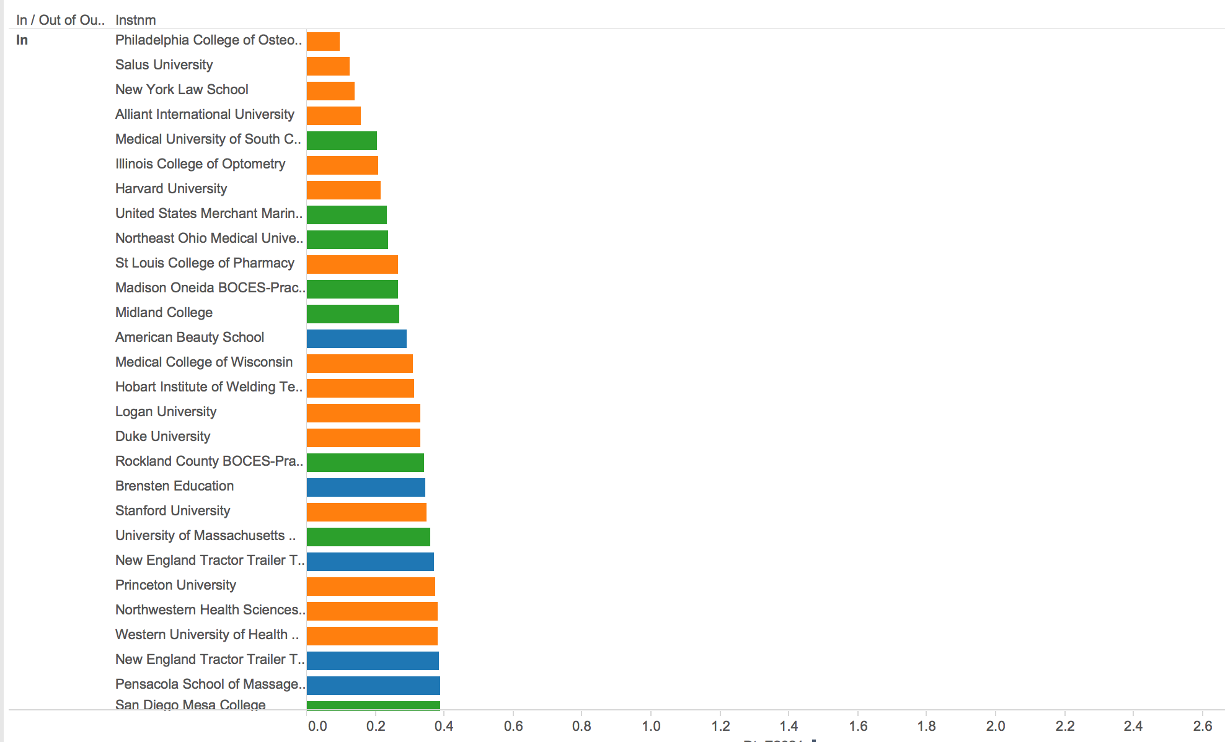
Recommendations - Outperformers
Notes:
Top 10 - Mainly Private-not for Profit and Public

Slide 19
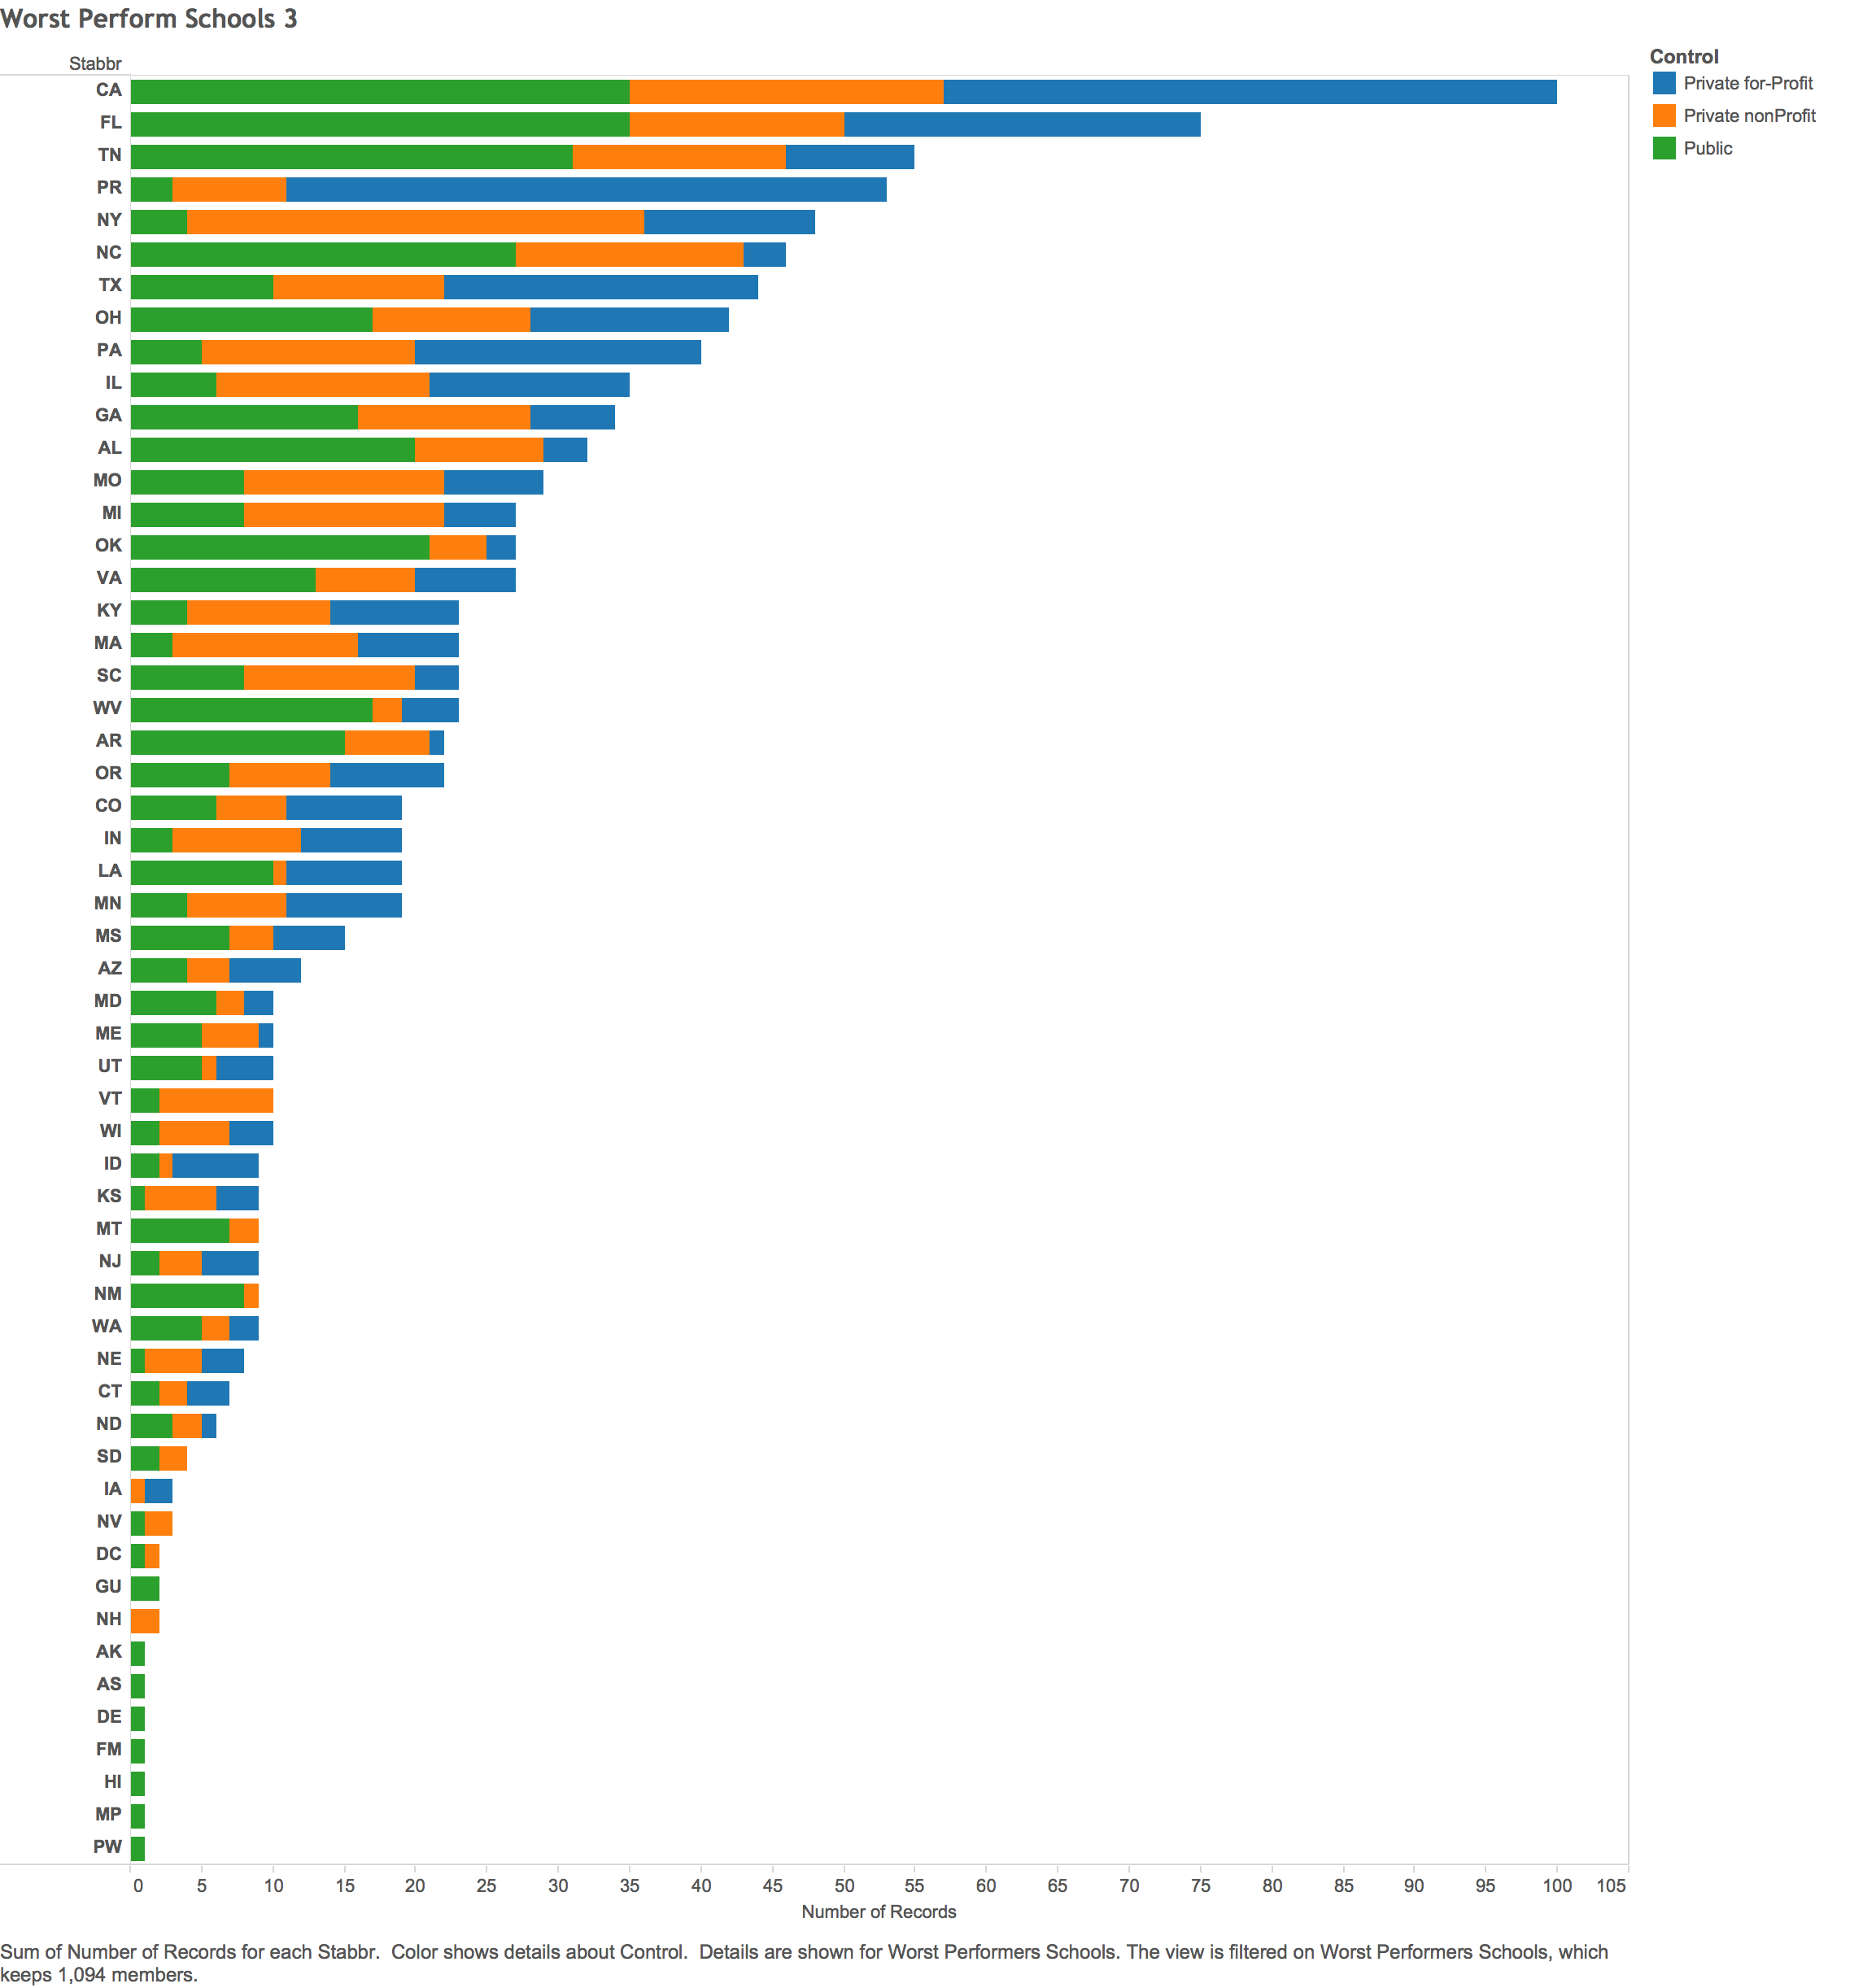
Recommendations - Worst Performers

Slide 20
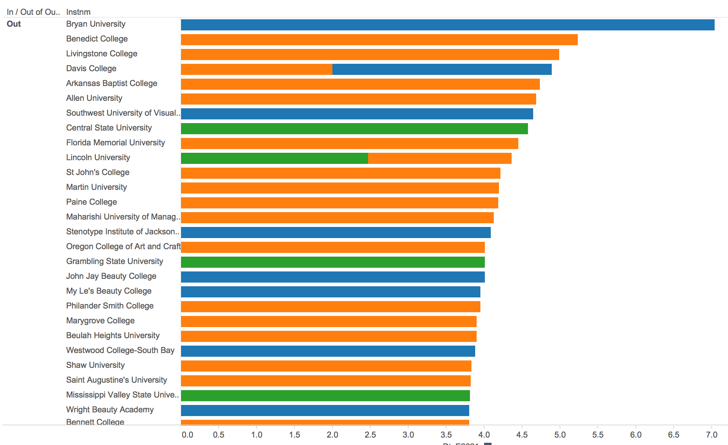
Recommendations - Worst Performers

Slide 21


I’ll leave you with this…

Slide 22
Thanks!
Any questions?

